Slide 1


Bonsai On A Budget
Alex Labram
October 2025
Nemeta Bonsai
nemeta.co.uk

Slide 2
Learning Outcomes – Day 1
Theory
Be aware of the history and culture of bonsai
Understand (at a high level) how a bonsai is produced
Understand (at a high level) what distinguishes good and bad bonsai
Know how to maintain a bonsai on a day-to-day basis
Experience the key activities of re-potting, pruning and wiring
Be aware of inexpensive options for further learning and practice
Practical
Watering bonsai
Wiring a bonsai pot for re-potting
Exposing the nebari
Potting the prepared tree
Pruning for bulk, congestion and taper
Wiring for shape

Slide 3
Bonsai: What & Why
Defining bonsai
A bonsai is a living trompe-l’oeil: a small tree that appears to be a scaled-down large tree.
Almost any kind of tree can become a bonsai (plus a few things that aren’t trees!)
“Bonsai” traditionally referred to Japanese schools, but has become a generic term
Why ’Sai?
Hands-on education in plant science!
Learn to see extra layers of beauty in nature
Good practical hobby with interesting culture
Sense of control and responsibility
  To see a World in a Grain of Sand
  And a Heaven in a Wild Flower
  Hold Infinity in the palm of your hand
  And Eternity in an hour
- William Blake

Slide 4
Bonsai: A Potted History
China
Daoist mysticism: recreation of magical sites in miniature
Penjing (盆景) / Penzei (盆栽) = the art of miniature landscapes (pre 600AD)
Popular amongst Buddhist monks, and – later – aristocracy
Heavily impacted by Mao’s Cultural Revolution: seen as a bourgeois pastime
Japan
First records c. 1200AD; known as Hachi-no-Ki (“potted trees” – also the name of a famous play!)
Heavy Zen / Chan Buddhist influence: beauty through austerity, sophistication in simplicity and perfection from imperfection (“wabi-sabi”)
Increasingly popular from 1800s onwards; term “bonsai” (盆栽 – “tray planting”) adopted
Development of distinct styles (dramatic archetypes)
Hit hard by World War 2, but revived in the aftermath (partly from enthusiasm of GIs)
Exported to West from 1960s onwards, in parallel with Japan’s “economic miracle”

Slide 5

Bonsai: Art & Science
Good bonsai practice is:
Authentic - makes you think “tree”
  Tree as biological / ecological process
Dramatic – makes you think “TREE”
  Tree as compositional element
Pragmatic – doesn’t make you think “dead tree”…
  Tree as living clay

Slide 6
Pragmatism 1
How Not To Kill Your Tree

Slide 7
What Kind Of Tree Is A “Bonsai”, Anyway?
Trick question alert!
Tree: “a large, tall, woody, perennial plant with a single, unbranched, erect, self-supporting stem holding an elevated and distinct crown of branches with a total height greater than ten feet and a diameter greater than three inches” – oy vey!
Almost any tree species can be trained into a bonsai; many smaller plants can too
Requirements for bonsai-ing:
  Vascular plant (no mosses!)
  Woody growth / “lignification” (no daisies!)
  Secondary growth of trunk (no palms!)
  Free-standing (no lianas!)
  Deep roots (no grasses!)
Desirable features
  Attractive / interesting species
  Small or pinnate leaves
  Long-lived
  Reasonably fast-growing
  Easy to maintain / shape
“Honorary” bonsai species
  Woody climbers: ivy, wisteria, honeysuckle
  Succulent / fleshy: dwarf jade, geranium
  Chrysanthemum

Slide 8
I Had One Once, But It Died
What a bonsai needs to survive
Environment
  Indoor vs Outdoor
Watering!!!!!
  Single biggest killer of bonsai
  “Root hairs” die easily in drought
  Over-watering is also dangerous!
Light
Heat
  Dormancy
Airflow
Pest Control
  Animals: spider mites, scale bugs, aphids, caterpillars, vine weevil, squirrels
  Plants etc: pearlwort, liverwort, wood sorrel, pennywort, nostoc
  Caution: environmental issues!
Fertiliser
  “Balanced”: roughly even NPK
  Organic => micronutrients
  Caution: environmental & ethical issues!
Bonsai are far harder to keep alive than most common pot plants!

Slide 9
Watering Your Bonsai
No, seriously, this is important
Why so serious?
Trees usually have deep tap-roots to draw water; they don’t handle drying out well
  …Especially conifers, for some reason
Good-quality bonsai soils / pots have really good drainage… so can dry off quickly
Bonsai soil is very compact and often moss-covered… so water tends to run off the surface
Traditional bonsai soil is inorganic, so lacks the “capillaries” of plant fibre that let water rise up through the pot
Even gardening experts routinely kill their first bonsai!
Watering methods
Put in bucket of water (to just below brim) and wait for water to bubble up
  …Then take out and allow to drain fully. Never leave standing in water for long periods – roots need oxygen too!
Water from above three times, allowing the water to sink in between passes
Is it watered enough?
Surface feels damp to back of hand
Pot significantly heavier
Water running out of hole in bottom

Slide 10
Authenticity & Drama
Thinking Like A Tree (That’s Seen Some S**t)

Slide 11
Arboriculture 101
What shapes a tree?
Sunlight
Airflow
Gravity / load
Shade
Animals

Slide 12
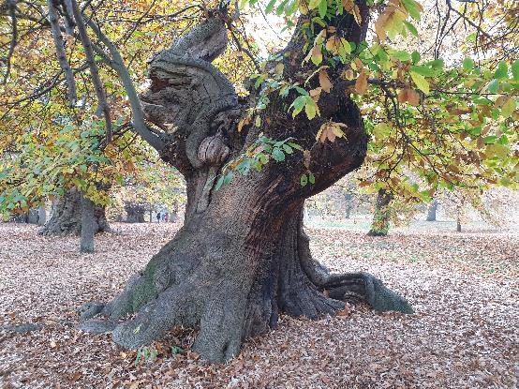
Authenticity & Age
What makes a tree look mature?
Canopy shape
  Rounded triangle
  Composed of rounded-triangle “pads” (for species that back-bud less readily)
Trunk & branch behaviour
  Short inter-node distance
  “Ramification”: fractal splitting of branches
  “Square-cube law”: big tree = proportionally heavier load = more curvature
  “Ruptures”: jagged direction changes
Texture
  Bark
  Dead-wood: advanced bonsai topic!
Taper
  “Nebari” (根張り) = root flare / buttress
  Trunk & branch flare: from base to apex / tip
  Trunk-to-branch (and branch to sub-branch) ratio

Slide 13
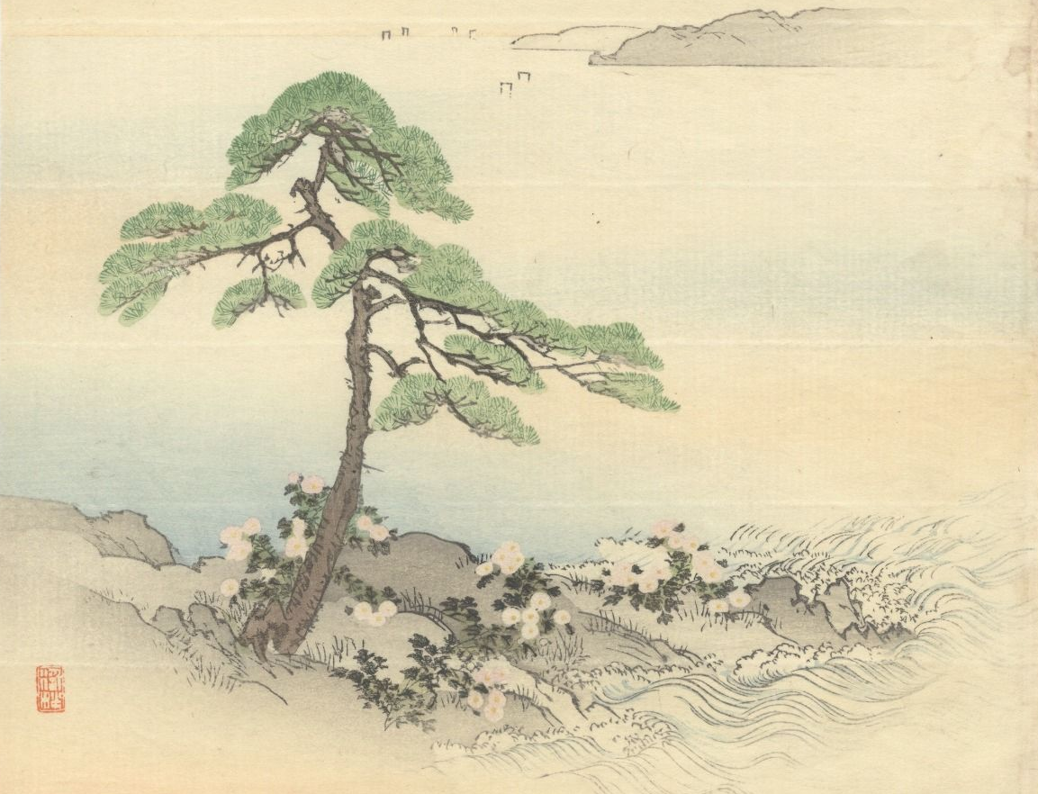
Art à la Japan
Catching the eye
Key elements of visual design:
Movement & rhythm
Balance: symmetry vs asymmetry
Similarity & harmony vs contrast & variety
Perspective & proportion
Repetition & continuation
Unity: wow factor
Japan-specific additions:
“Wabisabi” (侘び寂び – literally “forlorn rusticism”): austere, naturalistic, often hard-worn beauty and elegance
Top-right to bottom-left traditional reading
  It is self-evident that nothing concerning art is self-evident.
- Theodore Adorno (1969)

Slide 14
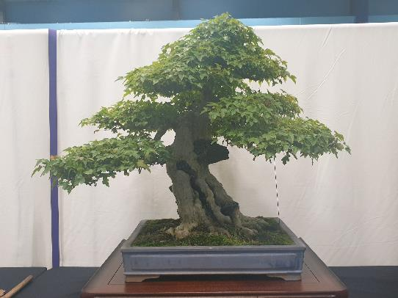
Drama & Perspective
What makes a tree stand out?
Taper (again!)
  Taper appears stronger from viewpoint at base of tree
Pot: picture-frame for tree
  “Heavy” earthenware vs “light” glazed
  Depth ≈ trunk thickness; width ≈ 2/3 canopy height (tall tree) or width (wide tree)
  Style: heavy vs light, plain vs ornate
Use of negative space
  …Often in imitation of wind-flow or trunk death in full-scale trees
Scaled-down decorations
  Moss “grass”, accent plants, rocks (“suiseki”)
Well-defined “front”
  Style is firmly established
  Sense of strength or movement captured
  Clear view of lower trunk
  No crossed branches
  Tree’s “centre of mass” is in middle of pot

Slide 15
Flaws
What gives the game away?
Obvious tool marks
  …Including wire scarring
Excessive symmetry
  …Especially handlebar branches
  Asymmetry is a common theme in Japanese gardening!
“Reverse taper”
Unusual “habit” for species / genus
  Google for pictures of wild tree to get ideas!
  This rule is frequently ignored: e.g. small shrubs portrayed as large trees, boringly-shaped species made interesting, unrealistic pads
Dead leaves and (unwanted) deadwood
Weak / immature-looking branches
  Suckers
  Congested nodes
  Under-slung / elbow branches
  Lack of clear “leader” (dominant trunk / branch)

Slide 16
Bonsai Styles
The most common four archetypes of… thirty? Really?!?
Formal Upright
Cascade
Strong, proud, “yang”
Pot: unglazed earthenware; simple shape; bulging
Can be hard to develop taper, especially on conifers
Flowing, falling
Pot: deep to make space
“Half-cascade” runs to base of pot; “cascade” goes below that
Informal Upright
Literati
Relaxed, elegant, “yin”
Pot: glazed; fluting; flowery
Broad range of possible shapes
Basically the default style!
Solitary, melancholy, bleak
Trunk: bare, ruptured, calligraphic
Pot: small to emphasise plant’s extravagant loneliness
Style derived from woodcuts in classic Chinese drawing guide

Slide 17
Appendices
Miscellaneous Technical Notes

Slide 18
How Often To Water
Some key factors
Pot
Depth: deep → less frequent
Shape: bulbous → less, fluting → more
Inner surface: glazed → more
Soil
Drainage: well-draining → more
Degradation: older → harder to water
Dressing: dead sphagnum and/or live moss covering → harder to water but less frequent
Tree
Maturity: older → less (in theory)
Fertilisation: heavy → more
Re-potting: recent → more
Environment
Wind: windier → more
Sun: sunny → more, shady → less
Heat: hotter → more, colder → less
Season: Winter = least, Summer = most
Warning: these factors are “non-linear”! A small increase in e.g. sun can mean a big increase in watering.
…Mostly it’s not worth the effort to figure out the “right” watering frequency. Just keep checking the pot every day!
Be especially wary when the temperature is rising.

Slide 19
Wiring a Bonsai Pot
What could go wrong?
Good enough
Mesh & Staple
(Plastic mesh, 2mm alum. wire)
Guy wires
(1.5mm alum. wire x 2)
wire above mesh
wire below mesh & pot
wire below mesh
wire above mesh & along sides of pot
one side of each wire longer than the other
view from short side
view from long side
extra bend makes it obvious which is the longer side
guy wire will be held in place by staple

Slide 20
Repotting step-by-step
✓
fingers
Regular repotting – often back into the same pot! - helps limit tree size via “root-to-shoot ratio”
1. Prepare pot
Pick a (tentative) pot
Scrub clean
Staple mesh over holes
Add guy wires
2. Prepare tree
Remove from pot
Clean off soil surface
Dig down to expose nebari
Choose “front” if not already clear
Dig up / in to define root-ball
Untangle lateral roots where poss. (esp. girdling roots)
Clear any growth from lower trunk
Spray with water if starting to dry!
3. Insert tree into pot
Add shallow layer of soil to base
Place root ball in pot and pack soil around
Compress soil to “brownie” hardness
Pull guy wires over root ball, twist pairs together tightly, and trim to 3-4 twists
Cover with dried, grated, rehydrated sphagnum and compress surface
Sprinkle with grated acrocarpous (upward-growing) moss
✗
Prone to snapping!
✗
Prone to snapping!

